Slide 1
SPECTRUM computation DFT TO FFT
Aug 10, 2017 Dinesh Babu J

Slide 2
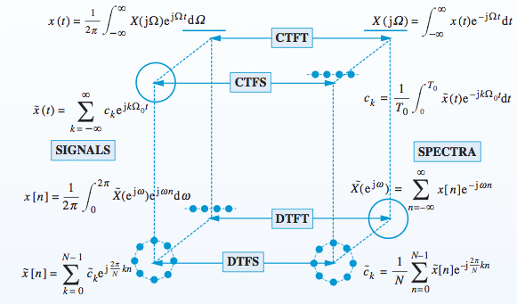
Spectra
1. Continuous, Discrete – signal
2. Periodic, Aperiodic - signal

Slide 3



Relation between DTFS and DFT
DFT

Slide 4
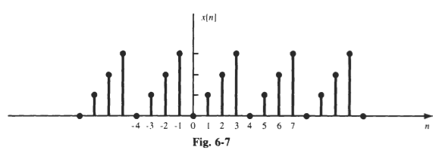

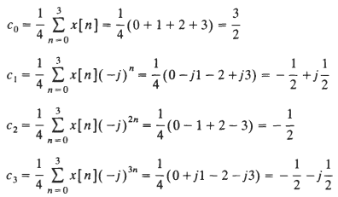


Compute Spectra: DTFS

Slide 5

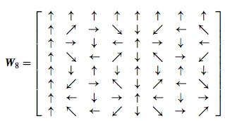
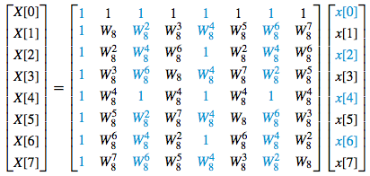
Discrete Fourier Transform to Fast Fourier Transform

Slide 6

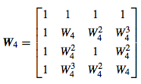
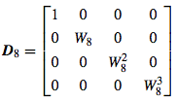
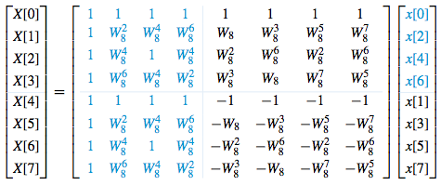


Fast Fourier Transform

Slide 7
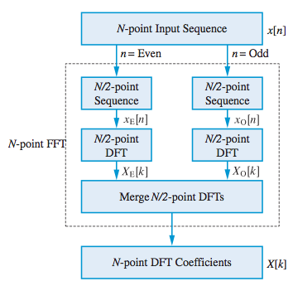
Fast Fourier Transform

Slide 8
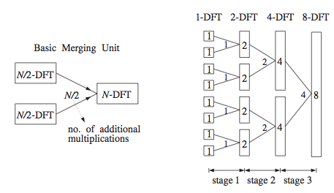





Fast Fourier Transform

Slide 9




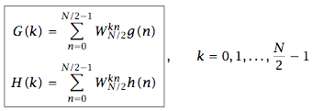

Decimation in time: Fast Fourier Transform

Slide 10


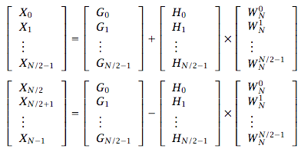
Decimation in time: Fast Fourier Transform

Slide 11
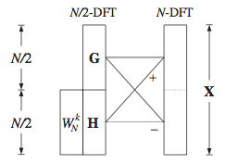
Decimation in time: Fast Fourier Transform

Slide 12

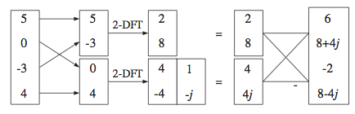
Twiddle Factors

Slide 13
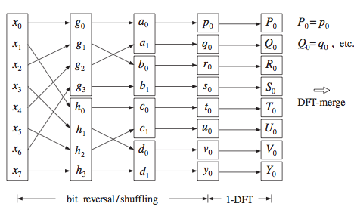
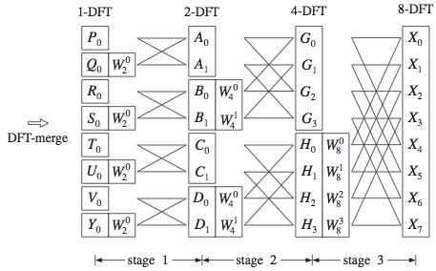
Decimation in time: Fast Fourier Transform

Slide 14
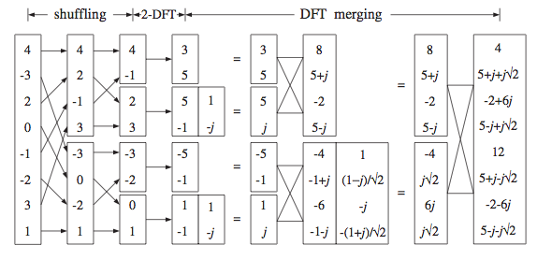
FFT (Decimation in Time)

Slide 15
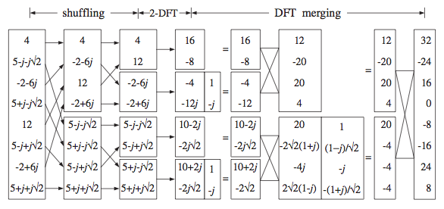
IFFT (Decimation In Time)

Slide 16
Conclusion
Continuous/Discrete, Periodic/Aperiodic
Spectrum: CTFS,CTFT,DTFS,DTFT
DTFS ⬄DFT; DFT=FFT(faster)
FFT Matrix viewpoint
Textbook: Applied DSP
FFT equations
Textbook: Signal Processing (Orfanidis)

